Slide 1
Background Tasks
Android Developer Fundamentals V2
Lesson 7

Slide 2
7.4 Services

Slide 3
Contents
Services for long tasks.
IntentService

Slide 4
Services is an advanced topic
Services are complex.
Many ways of configuring a service.
This lesson has introductory information only.
Explore and learn for yourself if you want to use services.

Slide 5
Services for Long Tasks

Slide 6

What is a service?
A Service is an application component that can perform long-running operations in the background and does not provide a user interface.

Slide 7
What are services good for?
Network transactions.
Play music.
Perform file I/O.
Interact with a database.

Slide 8
Characteristics of services
Started with an Intent.
Can stay running when user switches applications.
Lifecycle—which you must manage.
Other apps can use the service—manage permissions.
Runs in the main thread of its hosting process.

Slide 9
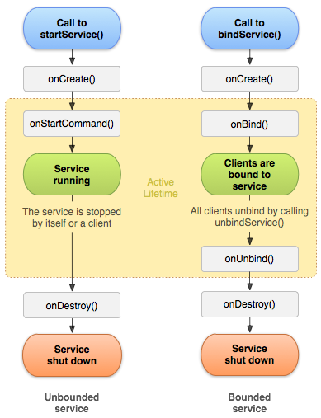
Forms of services: started
Started with startService()
Runs indefinitely until it stops itself
Usually does not update the UI

Slide 10
Forms of services: bound
Offers a client-server interface that allows components to interact with the service
Clients send requests and get results
Started with bindService()
Ends when all clients unbind

Slide 11
Services and threads
Although services are separate from the UI, they still run on the main thread by default (except IntentService)
Offload CPU-intensive work to a separate thread within the service

Slide 12
Updating the app
If the service can't access the UI, how do you update the app to show the results?
Use a broadcast receiver!

Slide 13
Foreground services
Runs in the background but requires that the user is actively aware it exists—e.g. music player using music service
Higher priority than background services since user will notice its absence—unlikely to be killed by the system
Must provide a notification which the user cannot dismiss while the service is running

Slide 14
Background services limitations
Starting from API 26, background app is not allowed to create a background service.
A foreground app, can create and run both foreground and background services.
When an app goes into the background, the system stops the app's background services.
The startService() method now throws an IllegalStateException if an app is targeting API 26.
These limitations don't affect foreground services or bound services.

Slide 15
Creating a service
<service android:name=".ExampleService" />
Manage permissions.
Subclass IntentService or Service class.
Implement lifecycle methods.
Start service from Activity.
Make sure service is stoppable.

Slide 16
Stopping a service
A started service must manage its own lifecycle
If not stopped, will keep running and consuming resources
The service must stop itself by calling stopSelf()
Another component can stop it by calling stopService()
Bound service is destroyed when all clients unbound
IntentService is destroyed after onHandleIntent() returns

Slide 17
IntentService

Slide 18
IntentService
Simple service with simplified lifecycle
Uses worker threads to fulfill requests
Stops itself when done
Ideal for one long task on a single background thread

Slide 19
IntentService Limitations
Cannot interact with the UI
Can only run one request at a time
Cannot be interrupted

Slide 20
IntentService restrictions
IntentService are subjected to the new restrictions on background services.
For the apps targeting API 26, Android Support Library 26.0.0 introduces a new JobIntentService.
JobIntentService provides the same functionality as IntentService but uses jobs instead of services.

Slide 21
IntentService Implementation
public class HelloIntentService extends IntentService {
public HelloIntentService() { super("HelloIntentService");}
@Override
protected void onHandleIntent(Intent intent) {
try {
// Do some work
} catch (InterruptedException e) {
Thread.currentThread().interrupt();
}
} // When this method returns, IntentService stops the service, as appropriate.
}

Slide 22
Learn more
Services overview
Background Execution Limits

Slide 23
What's Next?
Concept Chapter: 7.4 Services
No practical

Slide 24
END

